Slide 1
COVID-19:
Wealth and Risk
Anita Adams, Randy Geszvain and Michael O’Keefe
7 June 2020
IST 707

Slide 2
1.
Introduction

Slide 3
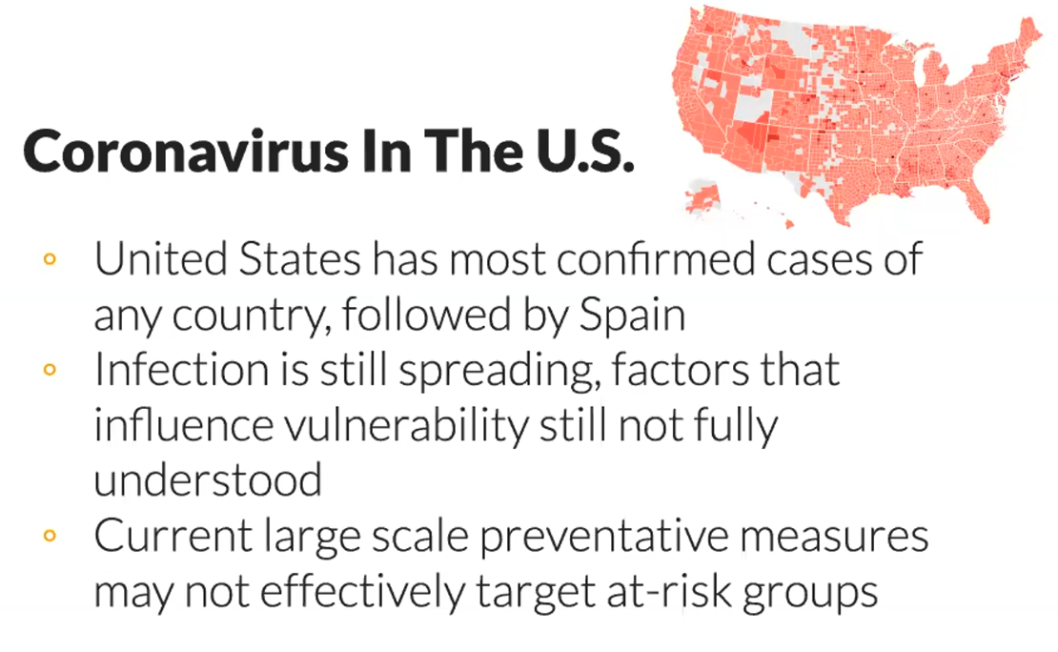

Slide 4
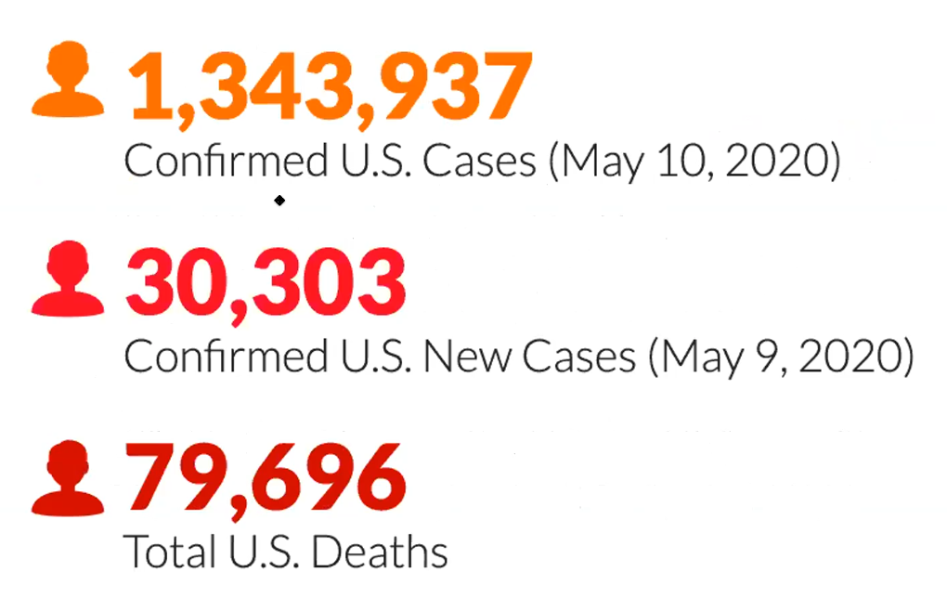

Slide 5
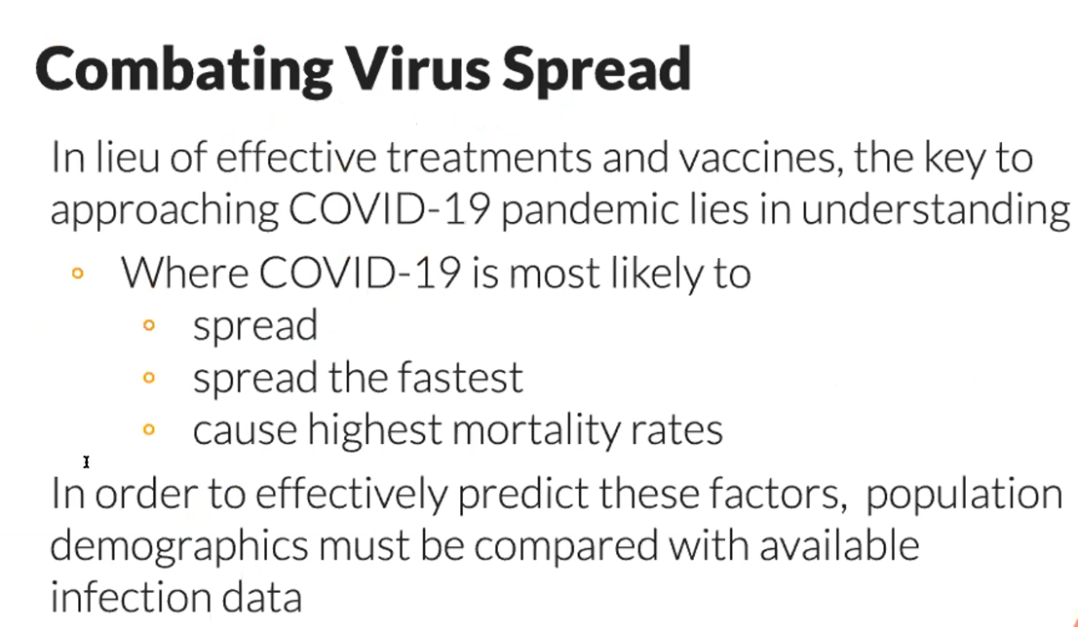

Slide 6


Slide 7
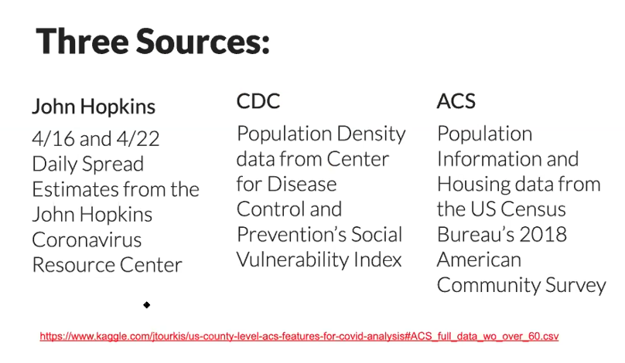

Slide 8
1.
EDA
Initial Results

Slide 9
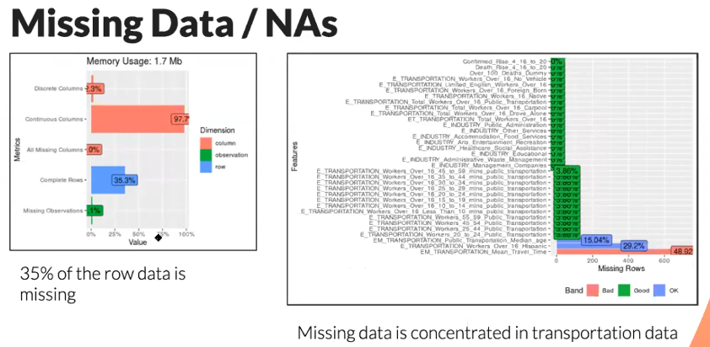

Slide 10
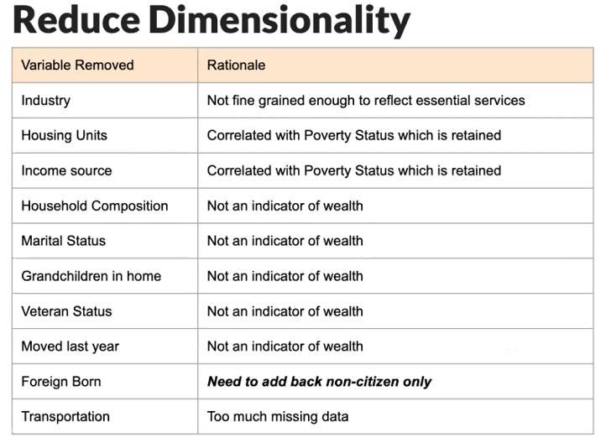

Slide 11
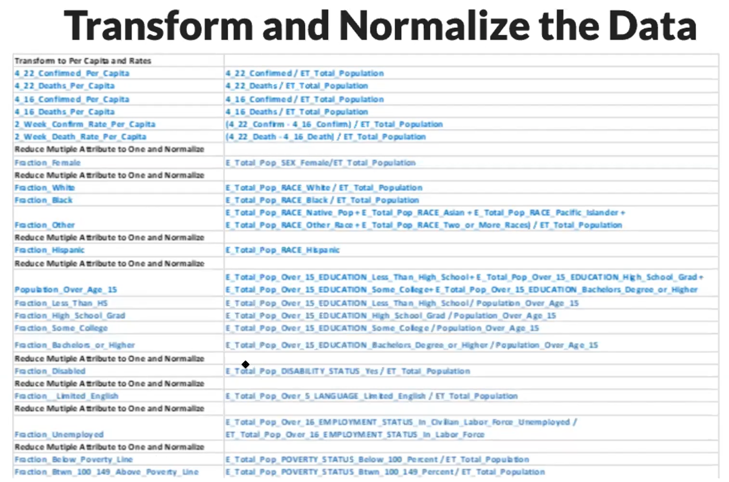

Slide 12
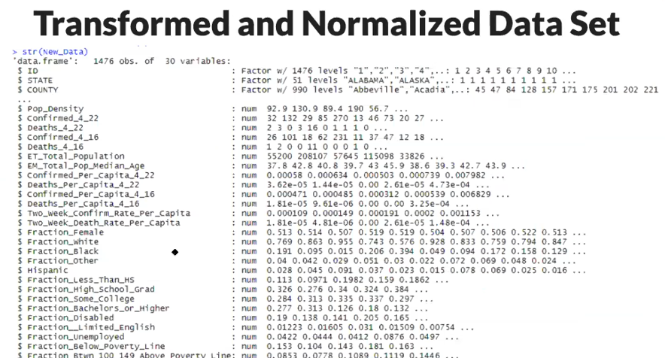

Slide 13
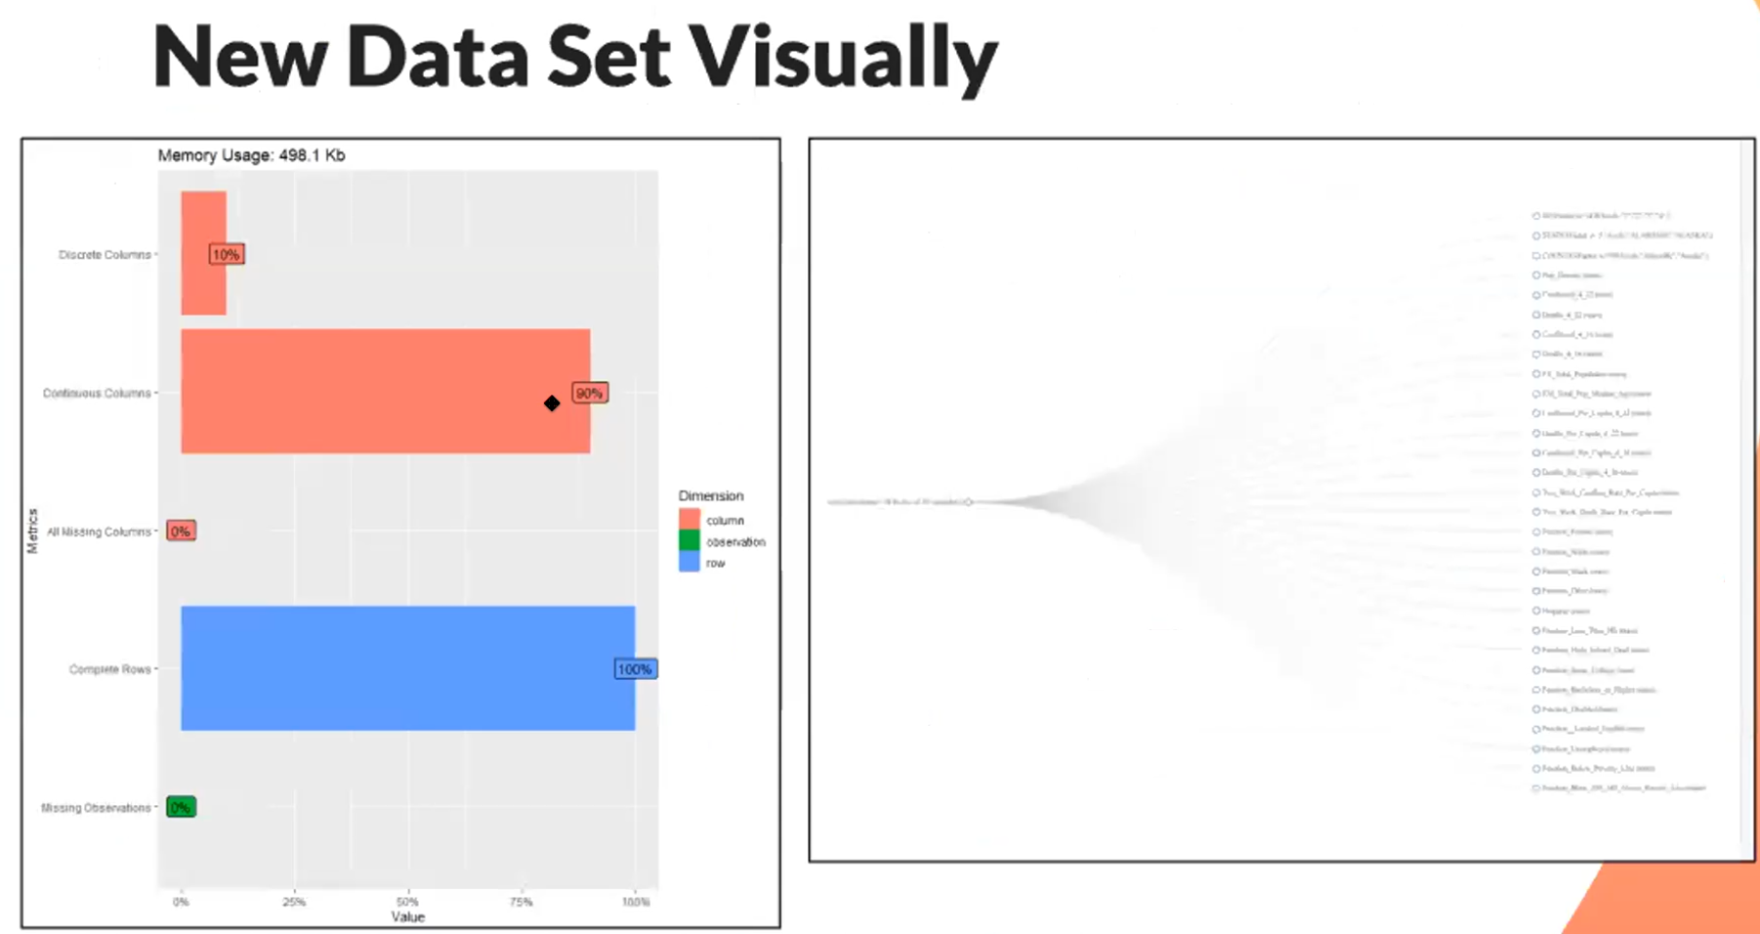

Slide 14
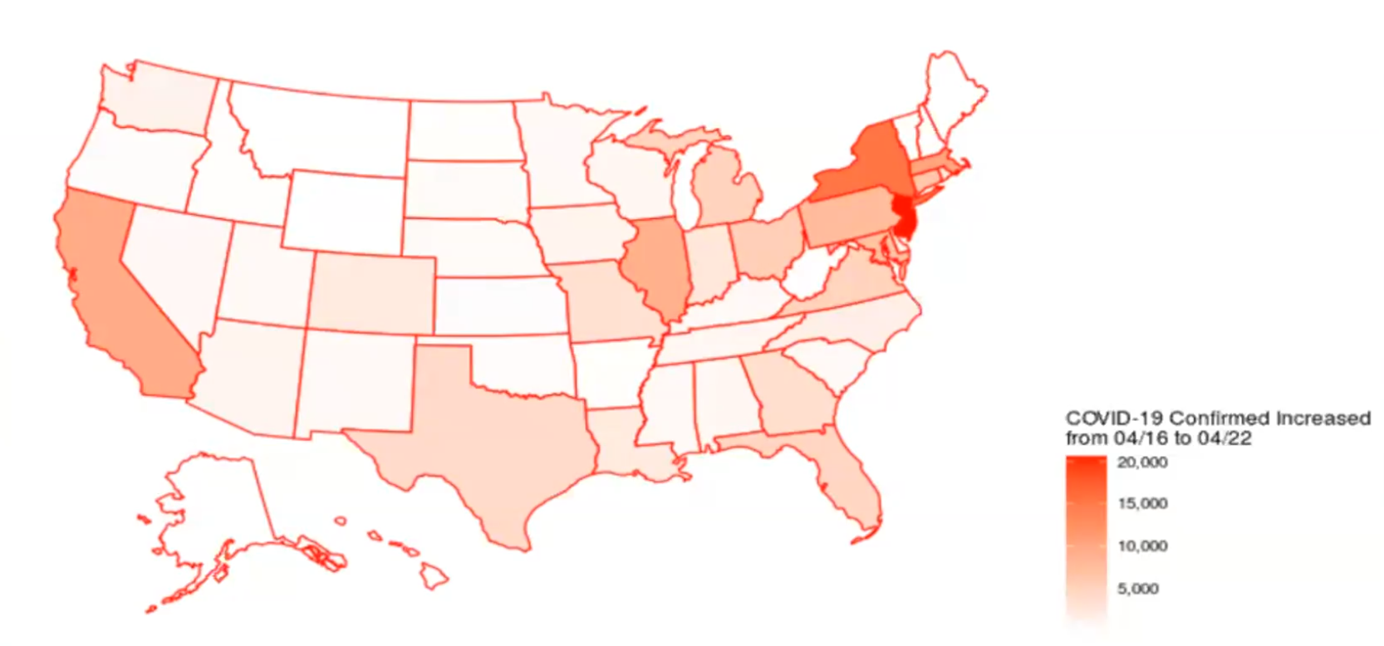
Rate In Confirmed Cases 4/16-4/22

Slide 15
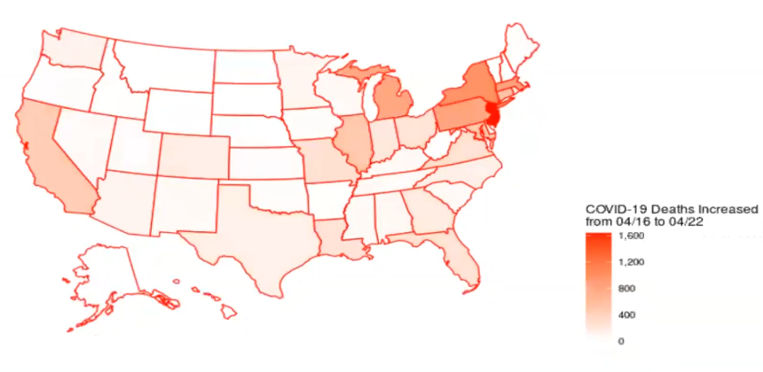
Change In Deaths 4/16-4/22

Slide 16
1.
Models
Plan

Slide 17
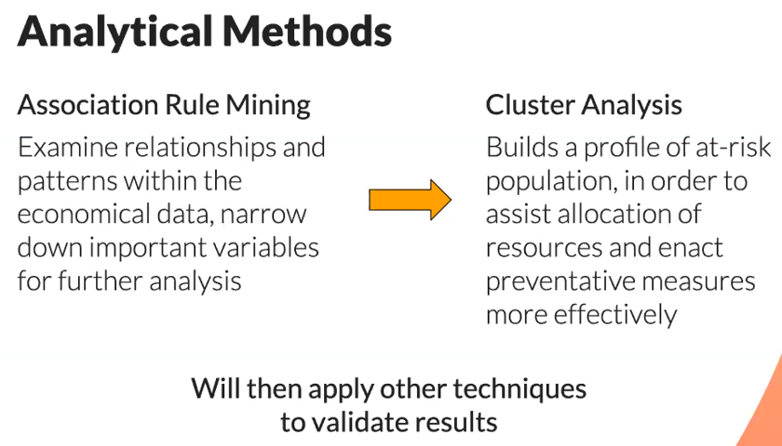

Slide 18
End

